Slide 1
CISC 610 DATA STRUCTURE AND ALGORITHMS
Vinee Shukla
ID:268743

Slide 2
Points Covered
Different types of data structure.
Advantages and disadvantages.
Practical applications of each.
How to decide when to use which data structure?

Slide 3
Definition of Data Structure
A data structure is a specialized format for organizing, processing, retrieving and storing data.

Slide 4
Data Structure Hierarchy
Types of data structure
Linear data structure
Non linear data structure
Stacks
Linked list
Tree
Graph
Queues
Array

Slide 5
Array
Arrays are the collection of elements with the same data type, these are stored at contiguous memory location.
Types of arrays :
1D array
2D array
3D array
Arr
1 | 2 | 3 | 4 | 5
Arr[0]
Arr[1]
Arr[2]
Arr[3]
Arr[4]
Index of the element

Slide 6
Advantages
It can represent multiple data elements with same data type.
Need to remember only first index of an array.
Arrays can be used to represent data structures like linked list, stacks, queues, trees, etc.
Disadvantages
Time complexity increases while insertion and deletion.
Memory wastage as the arrays are of fixed size.
Arrays are static, i.e. if once the array is declared the size cannot be changed.
Access | Search | Insertion | Deletion
O(1) | O(N) | O(N) | O(N)

Slide 7
Practical Applications of Arrays
Arrays used for matrix operations.
Arrays can be used to represent data structure like linked list, stacks, queues, trees, etc.
How to decide when to use array data structure ?
A random access of elements is needed.
If we know the number of elements ahead of the time.
If the speed of iterating through all the elements needs to increased. The arrays can do that, as they are stored in sequence.
When memory is a concern, as compared to linked list where each element have a pointer which takes up an extra space. At this time arrays can be used.

Slide 8
Stacks
Stack is a data structure where items are added in LIFO (Last in Fist Out) order. Adding an object to stack is called PUSH and removing an object from the stack is called POP.
PUSH A, PUSH B, PUSH C, PUSH D, PUSH E , POP , POP.
POP
POP
E
D
C
B
A
C
B
A

Slide 9
Advantages
Stacks can easily add and remove elements unlike arrays.
The memory management is not needed as stacks can allocate and deallocate automatically.
Access | Search | Insertion | Deletion
O(N) | O(N) | O(1) | O(1)
Disadvantages
Random access is not possible.
Stack memory is limited.

Slide 10
Practical applications of stacks
The mechanism known as “Undo” in text editors uses stacks.
Infix, postfix and prefix conversion.
Used during DFS in trees.
Decimal to binary conversion
How to decide when to use stack ?
When we need a data in reverse order.

Slide 11
Queues
A queue is data structure where items are added and removed in FIFO(First in First Out). Adding an item in queue is ENQUEUE and deleting an item is DEQUEUE.
ENQUEUE A, ENQUEUE B, ENQUEUE C, ENQUEUE D, DEQUEUE,
ENQUEUE E
A | B | C | D
B | C | D
B | C | D | E

Slide 12
Advantages
Queues are faster and flexible.
Queues are of infinite length i.e. no need to predefine the length.
Disadvantage
Queues are not indexed.
Only the element from the head can be removed.
Sequential access is slow.
Access | Search | Insertion | Deletion
O(N) | O(N) | O(1) | O(1)

Slide 13
Practical applications of queues
Job scheduling
Categorizing data
CPU scheduling
How to decide when to use queues?
Serving multiple requests on a single shared resource or machine.
Queues can be used when we need data in the particular order it was inserted.

Slide 14
Linked List
Liked list is a linear data structure that contains objects called as Cell. Those cells contains data as well as the link to other another cell.
Types of Linked list:
Singly liked list
Doubly linked list
Circular linked list
Data | Link
Data | Link

Slide 15
Singly linked list
Singly linked list is a list in which each cell is connected to the following list using links

Slide 16
Doubly Liked List
Doubly linked is a list, in which each cell have a link that points to the next and previous element in the list.

Slide 17
Circular Liked List
Circular liked list is a list whose last cell link points back to the first item in the list.

Slide 18
Advantages
Linked list have dynamic memory allocation.
Insertion and deletion are easier as compared arrays.
As linked list uses runtime memory hence, there is no wastage of memory.
Stacks and queues are easily implemented using linked list.
Disadvantages
Traversal of elements are difficult in linked list.
We cannot access random elements from the list.
Reversing is much more difficult.

Slide 19
Practical applications of linked list
Linked list are used in all the “ file requestor ” dialog.
Doubly linked list can be used to implement stacks, queues and Binary trees.
Image viewer and web browser – As the previous and next pages are linked and we will be able to access by the next and previous buttons. We can also access the previous and next url which are linked together by using linked list.
Circular linked list are used in our computers, where multiple applications are running at a time. All these applications are placed in a circular linked list and the operating system gives a fixed time slots for running each application. The operating system keeps on iterating the linked list until the application is completed.
When to use a linked list ?
When we want to maintain a directory of names.
Inserting and deleting in an array is difficult and expensive, so we can use linked list.
When we need a dynamic size data structure.

Slide 20

Trees
Trees are non linear data structure , it is a collection of nodes by directed or undirected edges.
Types of trees:
Binary
Binary search
AVL
B + and B-
Red-black
Heap

Slide 21
Binary trees
The most basic tree is called as binary tree where each node have max of two child.
When all the interior nodes have two children and all leaves have the same depth then the binary tree is called a perfect tree.
When every node in a binary tree have 0 or 2 children it is called as full binary tree
In a binary tree where every level, except possibly the last, is completely filled, and all nodes in the last level are as far left as possible then its called as complete binary tree

Slide 22
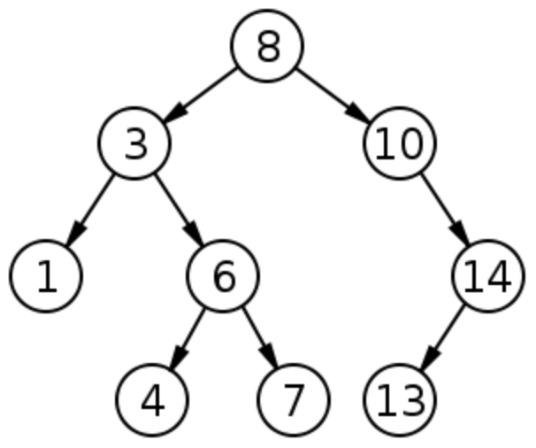
Binary Search Trees
A binary search tree t is binary tree such that either t is empty or :
Each element in the leftTree is less than the root element of t.
Each element in the rightTree is greater than the root element of t.
Both leftTree and rightTree are binary search tree.

Slide 23
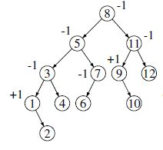
AVL Trees / Height Balanced Binary Tree
An AVL tree is a binary search tree that either is empty or in which:
The heights of the left and right subtrees differ by at most 1, and
The left and right subtrees are AVL trees

Slide 24
Advantages
They provide efficient insertion and deletion.
Allow moving of subtree with minimum effort.
They are represented as hierarchy.
Trees can be used while working with large amount of data
Disadvantages
Data is not in ordered form.

Slide 25
Practical applications of trees
Searching
Prioritizing jobs.
Describing mathematical expressions and syntactic elements of computer programs.
Organizing the information needed to drive data compression algorithms.
Domain name server.
Machine learning algorithms.
How to decide when to use tree?
When we want to store data in a hierarchy format example, the file system on computer.
Trees are used when we need to organize data for quick search, insertion and deletion.

Slide 26
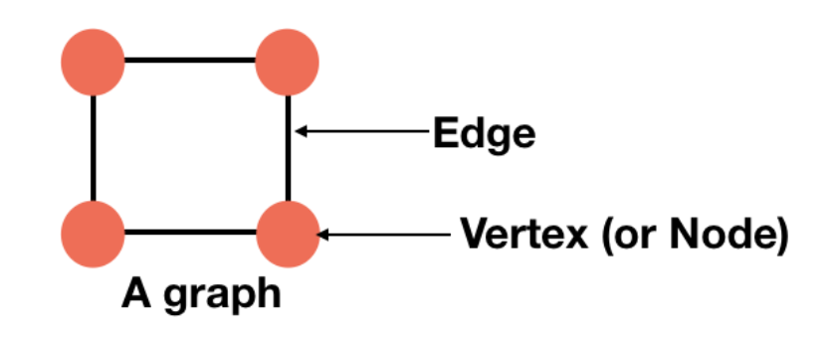
Graphs
Graph is a data structure that consists of following two components:
A finite set of vertices also called as nodes.
A finite set of ordered pair of the form (u, v) called as edge.
Graphs can be represented mainly in two ways:
Adjacency list - The vertices of graph is represented by a linked list.
Adjacency matrix – It is used to represent finite graph, the elements of the matrix indicate whether the pair of the vertices are adjacent or not to in graph.

Slide 27
Advantages
Graphs allows you to store the information about the relationship between nodes or components.
It is easier to diagnose a problem in a graph.
Disadvantages
It consumes large amount of memories, for storing big graphs.
It is difficult to construct a graph structure

Slide 28
Practical applications of graphs
Modeling connectivity in computer and communications networks.
Representing a map as a set of locations with distance between locations: used to compute shortest routes between locations.
Finding a path from a starting condition to a goal condition, for example in artificial intelligence problem solving.
Modeling flow capacities in transportation networks.
How to decide when to use graphs ?
When we need to determine the shortest path.
While determining the order of the courses so that the prerequisite courses are already taken.
Determining if there is a way to reach from one point to other just by following the links.

Slide 29

This Photo by Unknown Author is licensed under CC BY-SA

